Slide 1


Seed Sync
Welcome to the Seed Sync project. This presentation outlines our vision for a mobile application that empowers farmers by connecting them directly to consumers.

Slide 2

Sudo_Sync Family:
NAME | UNIVERSITY- ROLL NO | DEPT | PHONE NO | COLLEGE MAIL
BHARATHWAJ K S | 192124033 | AI & DS | 9840075725 | 192124033.sse@saveetha.com
MANIK RAKSHAN I | 192110070 | CSE | 9342699432 | manikrakshan0070.sse@saveetha.com
ILARIO KAGOO S | 192125047 | AI & ML | 9025481102 | ilariokagoo5047.sse@saveetha.com
HARI RAJA PRABHU P | 192110091 | CSE | 8940645820 | hariprabhu0091.sse@saveetha.com
ANJANA E | 192121017 | IT | 7904342001 | 192121017.sse@saveetha.com
HARIHARAN K | 192111708 | CSE | 7338848510 | hariharanhariharan1708.sse@saveetha.com

Slide 3
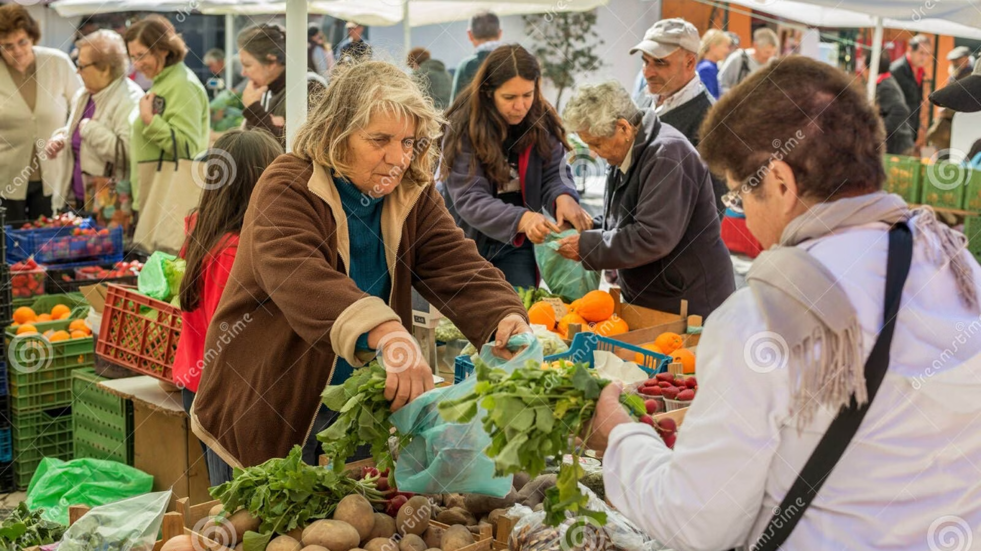
Problem Statement
Limited Market Access
1
Farmers often struggle to find reliable buyers for their produce, leading to limited income and waste.
2
Price Volatility
Fluctuating prices in traditional markets can make it difficult for farmers to plan and earn a stable income.
Lack of Consumer Connection
3
Consumers often lack awareness of the challenges farmers face, leading to a disconnect between production and consumption.
Farmers face challenges in accessing fair markets and reaching consumers directly. Traditional supply chains often lead to price fluctuations and unfair profits for middlemen. This creates a disconnect between farmers and consumers, hindering economic growth for both parties.

Slide 4
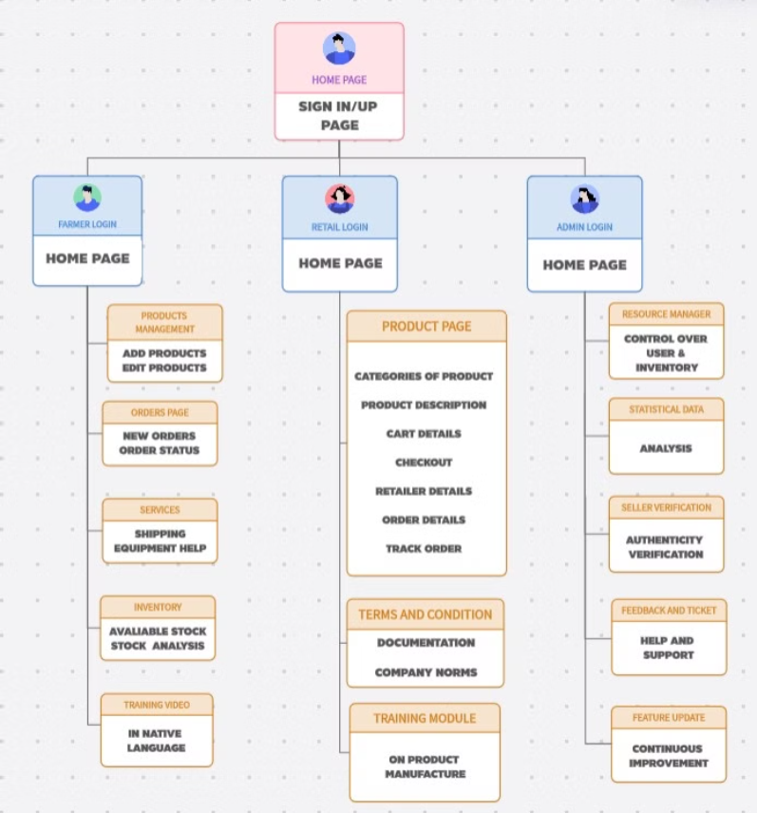
App Over View/ Flowchart

Slide 5

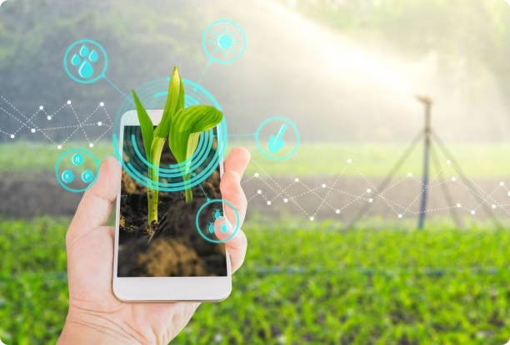



Proposed Solution
We propose a mobile application that connects farmers directly to consumers, eliminating middlemen and empowering both parties. The app will allow farmers to showcase their produce, manage inventory, and engage with potential customers.
Direct Market Access
Transparent Pricing
Community Building
Farmers can list their produce directly on the app, reaching a wider audience of consumers.
Consumers can see the actual cost of produce, understanding the value farmers bring.
The app fosters a community where farmers and consumers can connect, share information, and build relationships.

Slide 6





Technology Stack
Database Management
MySQL serves as the primary database management system, allowing for structured data storage and retrieval, while XAMPP provides a local development environment that facilitates testing and debugging before deployment.
Robust Backend Infrastructure
The backend is powered by PHP, providing a reliable server-side functionality that supports complex business logic. PHP is widely used for generating dynamic content by interacting with databases, such as MySQL, which allows web applications to serve personalized user data and content efficiently.
Server & Hosting:
XAMPP: Local server environment for development and testing. XAMPP is an open-source local server environment used for developing, testing, and deploying web applications on a local machine. It packages together essential components like Apache (the web server), MySQL (database), PHP, and Perl, making it a convenient tool for web developers.
Fronted Infrastructure
Flutter: Cross-platform framework for building natively compiled applications for mobile, web, and desktop from a single codebase. Flutter is a popular cross-platform framework developed by Google that enables developers to build natively compiled applications for mobile (iOS & Android), web, and desktop from a single codebase
Real-time Data and Inventory
Firebase: Platform for building mobile and web applications, providing services like real-time database, authentication, and cloud messaging. Firebase enhances real-time data synchronization and user authentication, ensuring a secure and responsive user experience.

Slide 7
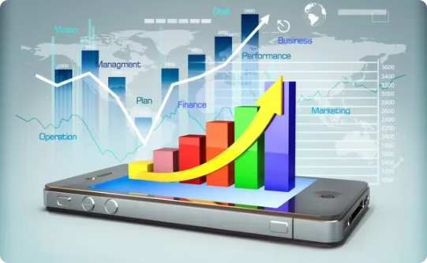
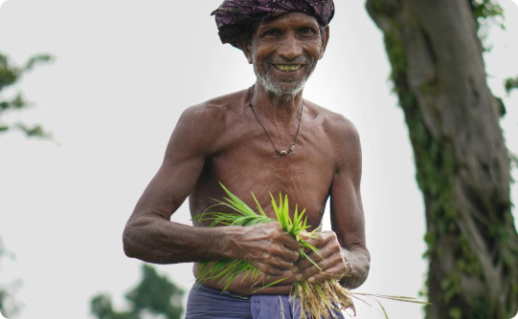

Feasibility and Viability
Market Analysis
User Feedback
Business Model
We conducted comprehensive market research to identify potential users and understand the existing challenges they face.
We gathered valuable insights through user testing and interviews to refine the app's features and functionalities.
We developed a sustainable business model that benefits both farmers and consumers, ensuring long-term viability.
Seed Sync has high feasibility and viability. The growing demand for local and sustainable produce, coupled with the increasing adoption of mobile technologies among farmers and consumers, creates a favorable market environment.

Slide 8




Challenges
While the Seed Sync app offers a promising solution, it's essential to acknowledge potential challenges and develop strategies to address them effectively.
Technical Challenges
Integrating with existing agricultural systems and ensuring seamless data transfer requires careful planning and technical expertise.
User Adoption
Encouraging farmers and consumers to adopt the new app requires effective marketing strategies and educational initiatives.
Security and Privacy
Protecting user data and ensuring secure transactions is paramount for building trust and confidence in the platform.

Slide 9
Mitigation Strategies
While challenges exist, the Seed Sync app is designed with several strategies to effectively address and overcome them.
Technical Solutions
Partnering with agricultural tech experts and leveraging modern tech ensures seamless integration with existing agricultural systems, allowing smooth data transfer and consistent performance.
User Adoption Initiatives
Through targeted marketing campaigns and farmer training programs, we will educate and encourage farmers and consumers to adopt Seed Sync. Simple interfaces and multi-language support make the app accessible to all users.
Security and Privacy Measures
To build trust and confidence, we prioritize data security by implementing end-to-end encryption and robust authentication methods, ensuring safe and secure transactions for all users.

Slide 10

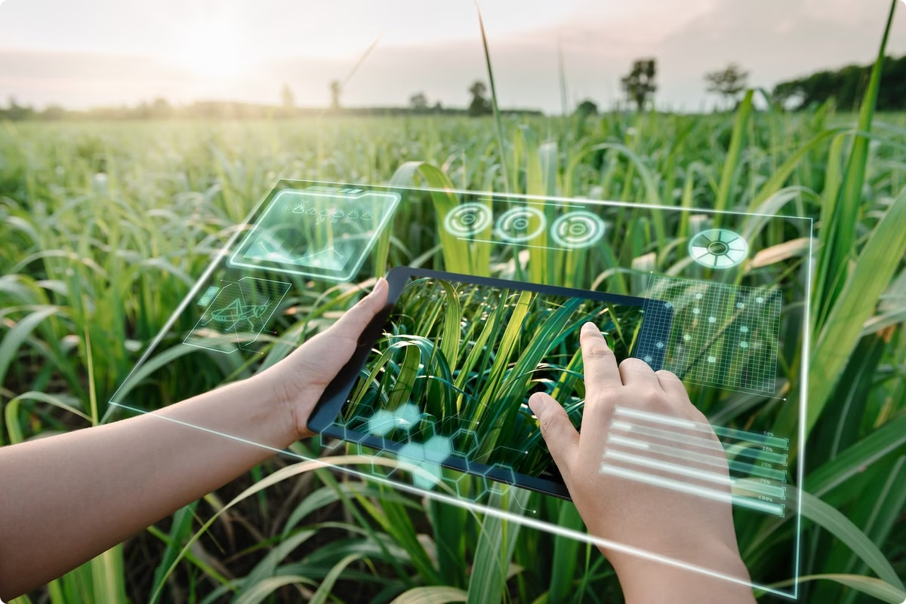
Impact and Benefits
The Seed Sync app has the potential to create a positive impact on both farmers and consumers. By addressing existing challenges and providing a user-friendly platform, it fosters a sustainable and equitable food system.
Increased Farmer Income
Empowered Consumers
Reduced Food Waste
Strengthened Local Communities
The Seed Sync app also offers a efficient Bidding system which helps the retailer and user to negotiate for higher purchase stock and helps both to receive best offer possible.

Slide 11
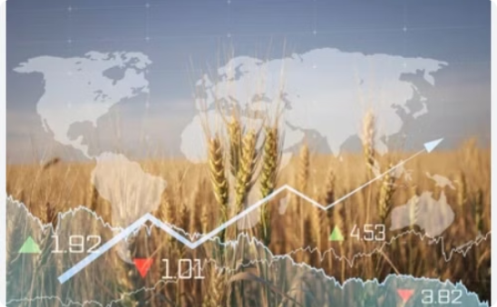
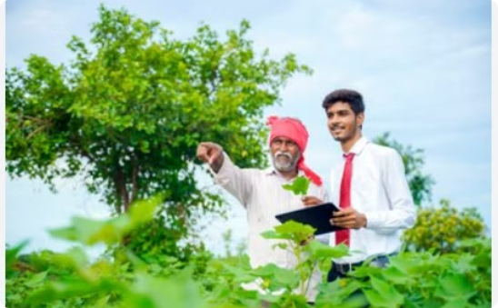
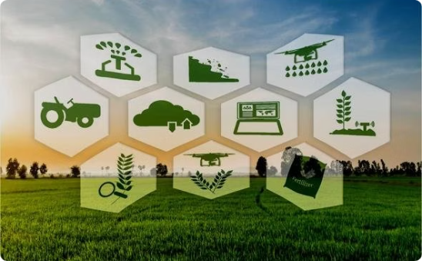
Conclusion
Growth
Partnership
Innovation
Seed Sync can foster growth for both farmers and consumers by connecting them directly and promoting sustainable practices.
Collaborating with stakeholders, including farmers, consumers, and local organizations, is crucial for the successful implementation of the Seed Sync app.
We are committed to continuous innovation and improvement, ensuring that the Seed Sync app remains relevant and effective in the future.
The Seed Sync app presents a powerful opportunity to revolutionize the way farmers connect with consumers. By overcoming challenges and leveraging technological advancements, we can create a more sustainable and equitable food system that benefits all stakeholders.

